Slide 1
Developing Characters
How to make characters that are interesting and don’t suck

Slide 2

Problem Character: Rey

Slide 3
Problem Character: Rey
Mary Sue
  Instantly and with no training able to perfectly perform feats that took other characters years to master.
    Flying the Millennium Falcon
    Using the Force to effect her own jailbreak
    Wielding a lightsaber without cutting her foot off
  Has no growth arc
  Replacement Luke
Self-insert of the author/producer
  Done by an insecure/inexperienced writer
    No flaws, no traps, no need to grow

Slide 4
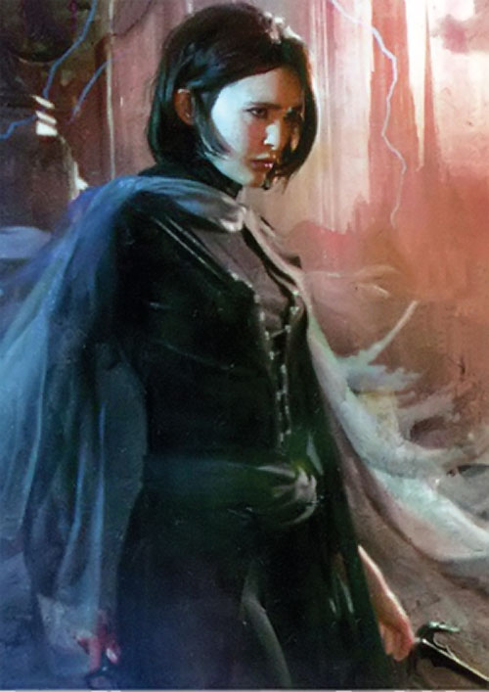
Good Character: Vin Ventrue (Mistborn)

Slide 5
Good Character: Vin
Starts off timid, scared, weak
  She knows she has a few tricks she doesn’t understand (Luck)
  She uses her “luck” economically (frugally)
  Fear of abandonment
  Living in a very anti-feminist world
Crosses paths with her mentors (Kelsier, Marsh, Clubs, Ham, Breeze)
  Recruited to join a “high end” thief ring
  Learns what her powers are and how to use them but DOES NOT instantly master them
  Spies on noble society and falls in love with the worst guy for her
    Fights with Kelsier (her father figure) over her boyfriend

Slide 6
How to avoid writing a weak/bad character
Features | Flaws
Physically strong Healthy Conventionally attractive Good family Within average to 1+ standard deviation beyond in intelligence (IQ 100 – 130) | PTSD* Fear of abandonment or loss that leads to not allowing anyone to be close Imposter syndrome Arrogant Thinks he’s a leader but he’s a bully
Short (like under 5’3) Pretty but more cute Half her face is covered by a purple birthmark | Bantam/Napoleon complex Manipulative Unable to stealth

Slide 7
How to avoid writing a bad character
Plan a growth arc that has the character deal with flaws head-on.
  They are NOT going to resolve the flaw the first time
  Each confrontation needs to get higher in stakes
  Character cannot escape the flaw without heavy cost
Use positive traits as flaws
  “Hot” can be a flaw in that the character (if female) is never taken seriously and is treated as if they are an idiot with the male characters preening for her affection
The character needs to change in more than one way

Slide 8
A word of warning
If you use mental/emotional illness as a flaw: RESEARCH IT and TALK to people who have been diagnosed with it by a real doctor with a real medical degree from a real place
Don’t rely on quick checklists
Remember that people are more than the stereotype

